Slide 1


UNIT-VI Organisational Culture and Change “Organisational Culture” by P. B. Narendra Kiran M.B.A., M.Phil., (Ph.D.) Assistant Professor Mittal School of Business, L.P.U., Phagwara, Punjab
Lecture-31

Slide 2


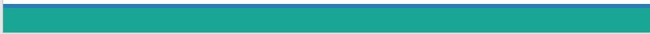

Slide 3

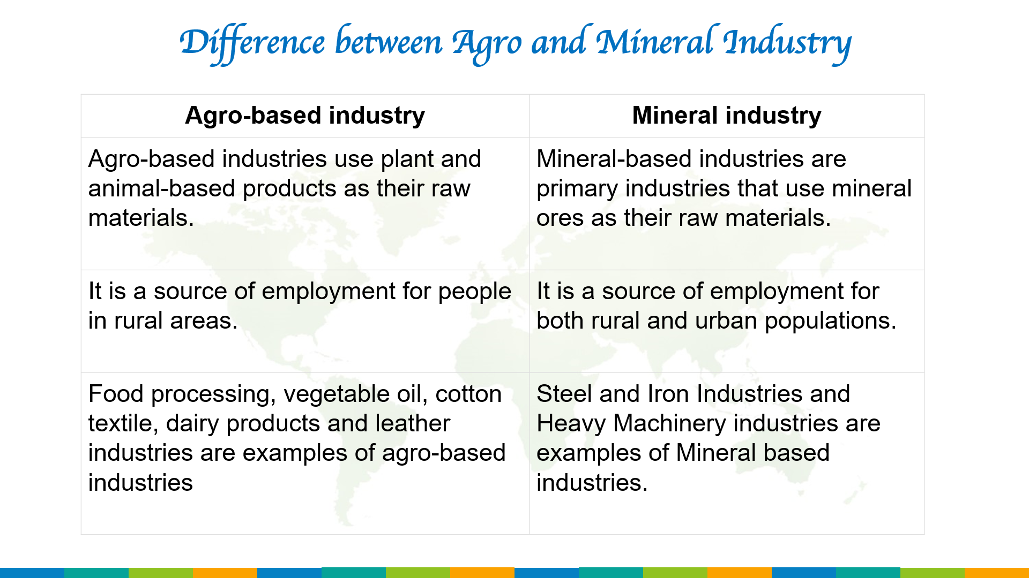
Objectives of the Study
Explain the Concept of Organisational Culture
Outline Dimensions of Organisational Culture
Describe the Types of Organisational Culture
To know the Iceberg model of Organisational culture

Slide 4
Introduction

Slide 5
Organisational Culture
Culture is the unique dominant pattern of shared beliefs, assumptions, values, and norms that shape the socialization, symbols, language and practices of a group of people.
The attitudes and approaches that typify the way staff carry out their tasks.
Culture is developed and transmitted by people, consciously and unconsciously, to subsequent generations.
Culture is embedded in the behaviour of individuals and can best be described as the personality of the organisation.

Slide 6
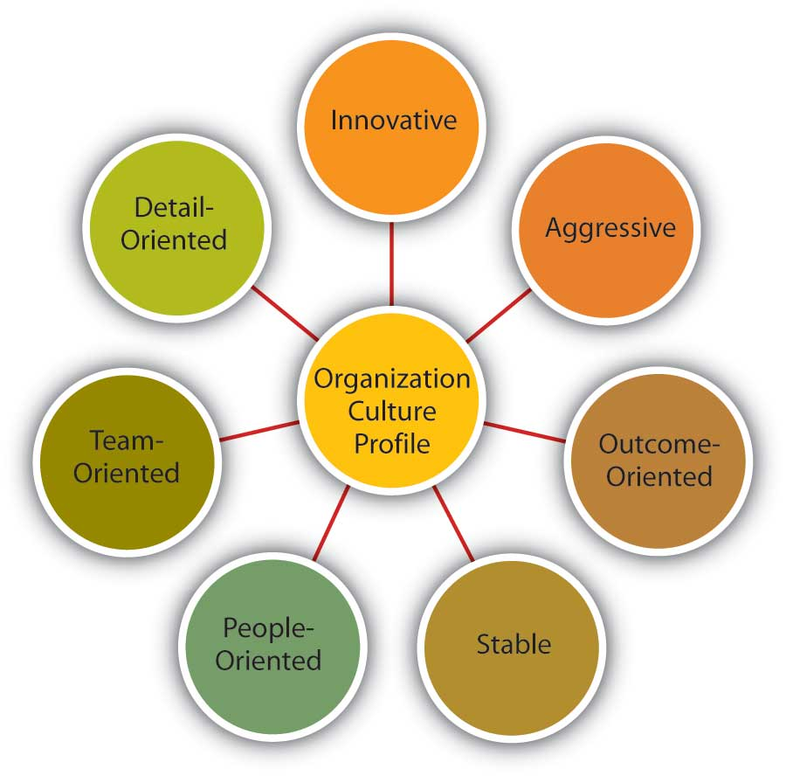
Characteristics of Organisational Culture
Organizational culture offers a shared system of meanings which is the basis for communications and mutual understanding.

Slide 7
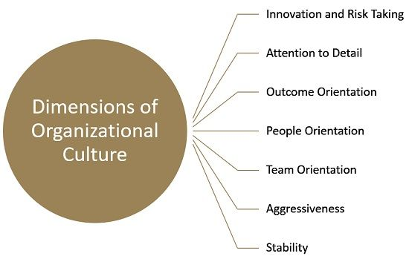
Dimensions of Organisational Culture

Slide 8
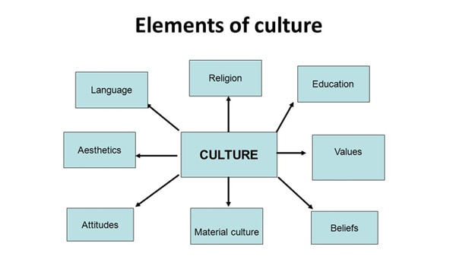

Slide 9
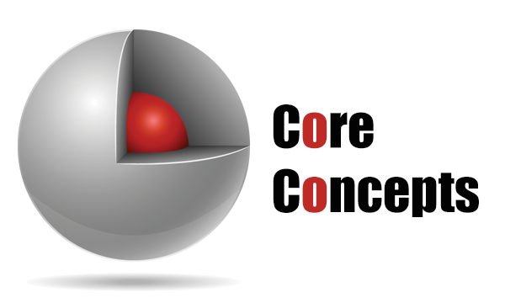

Slide 10
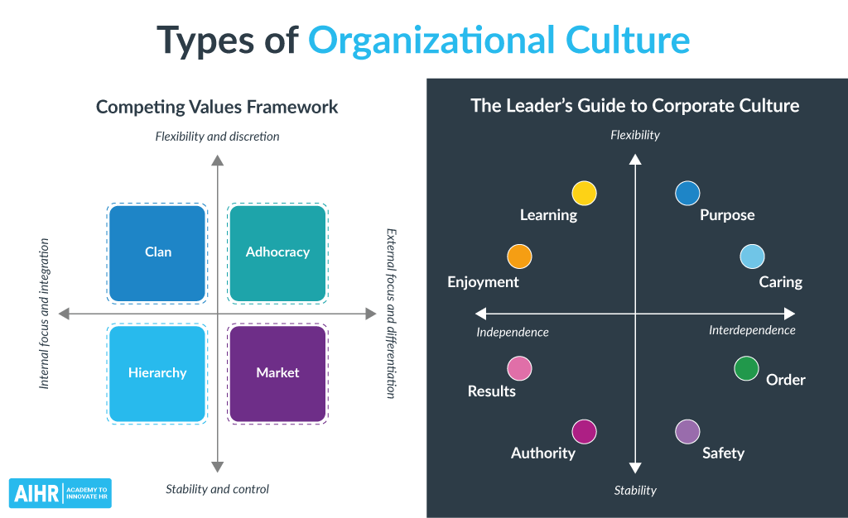

Slide 11
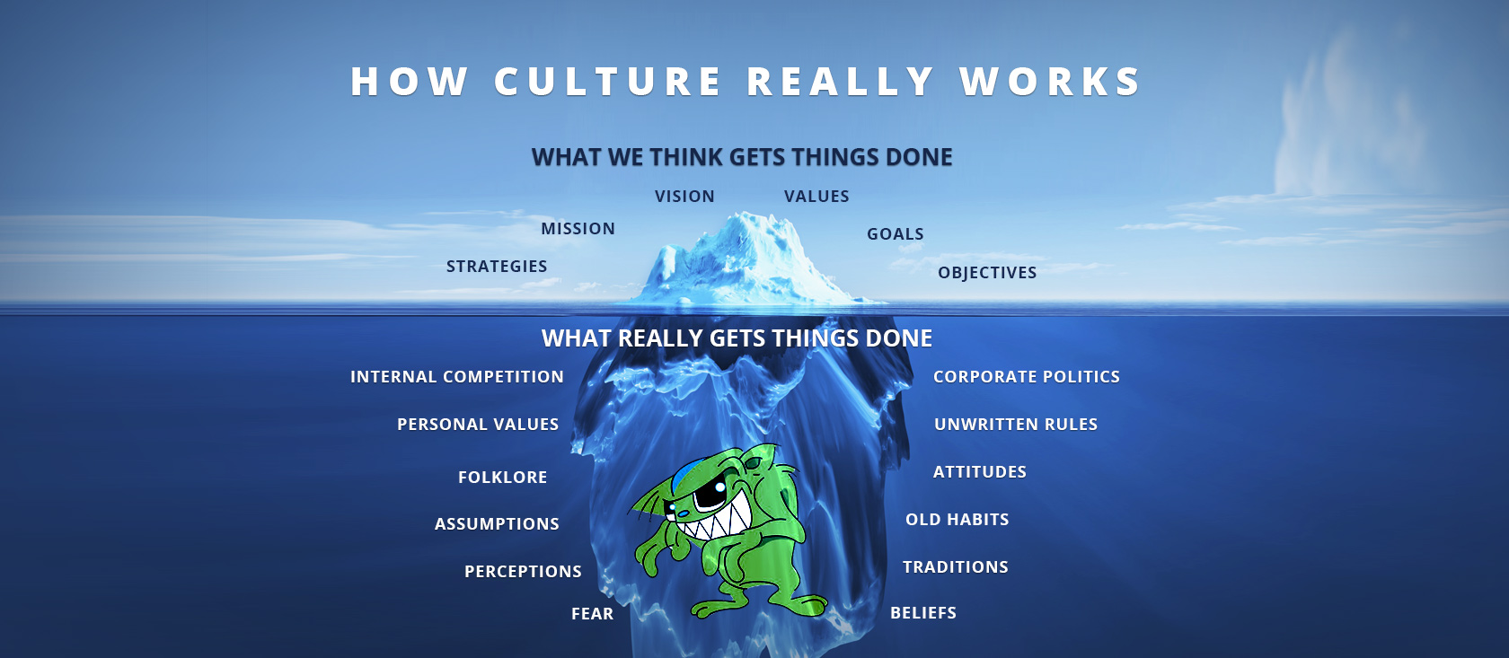
Iceberg Model of Organisational Culture

Slide 12
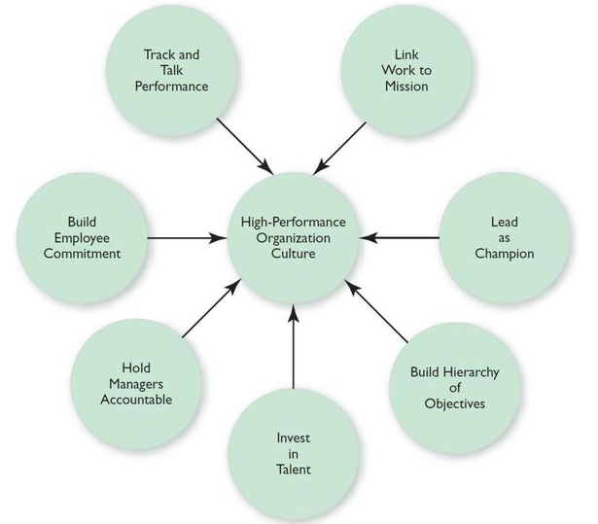
Building a high performance Organisational Culture

Slide 13
Thank you

Slide 14

Guidelines for improving communication
Clarify the purpose of the message
Use intelligible encoding
Consult others views
Consider receivers needs
Use appropriate tone and language and ensure credibility
Get feedback
Consider receivers emotions and motivations
Listen

Slide 15
Tips for improving Written communication
Use simple words and phrases
Use short and familiar words
Use personal pronouns (such as “you”) whenever appropriate
Give illustrations and examples; use charts
Use short sentences and paragraphs
Use active verbs, such as “The manager plans….”
Avoid unnecessary words.

Slide 16
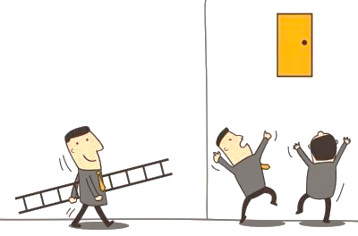
Challenges
21st
Century Challenges

Slide 17

Any Questions

Slide 18
Thank You

